Slide 1
NoN-Comparison Based Sorting
Section: L2
CS 412: Algorithms: Design & analysis

Slide 2
Group Members
Muhammad Sabihul Hasan (mh04387)
Hasan Naseem (05102)
Saad Ahmed Khan (sk04293)

Slide 3
OVERVIEW
The sorting algorithms we have covered in our course can sort a structure of strings or integers after comparing each value with another value in the data structure followed by rearranging of those values.
However, you can also sort or arrange items without comparing with them with each other.
There are some sorting algorithms that perform sorting without comparing the elements rather by making a certain assumptions about the data they are going to sort. The process is known as non-comparison sorting and algorithms are known as the non-comparison based sorting algorithms.

Slide 4
NoN-COMPARISON BASED SORTING
No-comparison sorting includes:
Counting sort which sorts using key-value,
Radix sort, which examines individual bits of keys, and
Bucket Sort which examines bits of keys.
These are also known as Linear sorting algorithms because they sort in O(n) time. They make certain assumptions about data hence they don't need to go through a comparison decision tree.

Slide 5
WHY NON-Comparison based Algorithms?
Looking at the performance of comparison based sorting algorithm, we will realize that Bubble sort, Selection Sort, and Insertion sort takes around O(n^2) time to sort n items.
While heap sort, quick sort, and merge sort takes O(nlogn) time on their best case and around O(n^2) on their worst case.

Slide 6
Count SORT
Counting sort is a sorting technique based on keys between a specific range. It works by counting the number of objects having distinct key values (kind of hashing). Then doing some arithmetic to calculate the position of each object in the output sequence.
The special conditions required for counting sort are:
The values to be sorted are integers in some range min to max. We'll call the number of values in the range k.
N >= k.

Slide 7
Count SORT
Step 1:
Store the count of each unique object in a set, in another set.
Step 2:
Modify the set such that each element at each index stores the sum of values at previous index.
Step 3:
Output each object from the set followed by decreasing its count by 1.

Slide 8
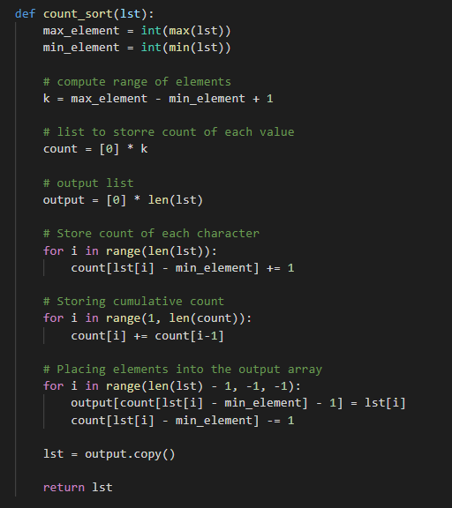

Slide 9
Time Complexity
Worst Case Complexity: O(n+k)
Best Case Complexity: O(n+k)
Average Case Complexity: O(n+k)
In all the above cases, the complexity is the same because no matter how the elements are placed in the array, the algorithm goes through n+k times.
There is no comparison between any elements, so it is better than comparison based sorting techniques.

Slide 10
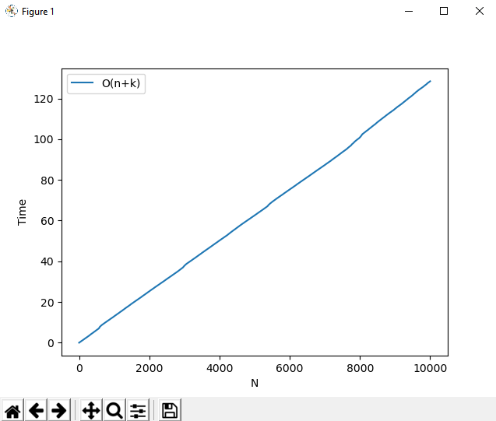

Slide 11
What if the elements are in the range from 1 to n^2?
We can’t use counting sort because counting sort will take O(n^2) which is worse than comparison-based sorting algorithms.
Can we sort such an array in linear time?

Slide 12
Radix SORT
The idea of Radix Sort is to do digit by digit sort starting from least significant digit to most significant digit.
Radix sort uses counting sort as a sub-routine to sort.

Slide 13
Radix SORT
Step 1:
Find the largest element in the set Let d be the number of digits of the largest element calculated because we have to go through all the significant places of all elements.
Step 2:
Now, go through each significant place one by one.
Step 3:
Use any stable sorting technique to sort the digits at each significant place. We have used counting sort for this.

Slide 14
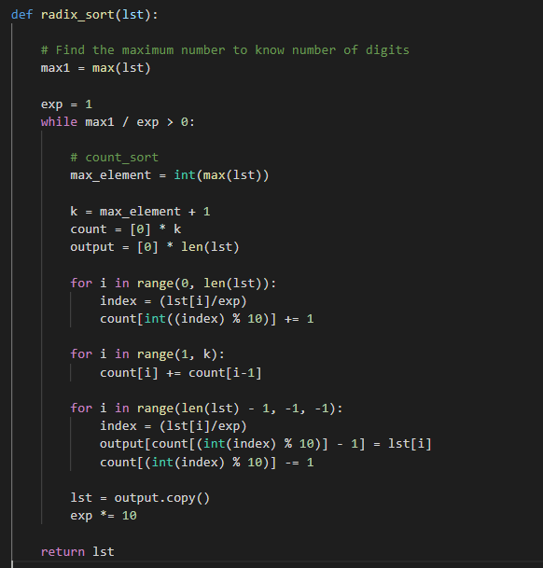

Slide 15
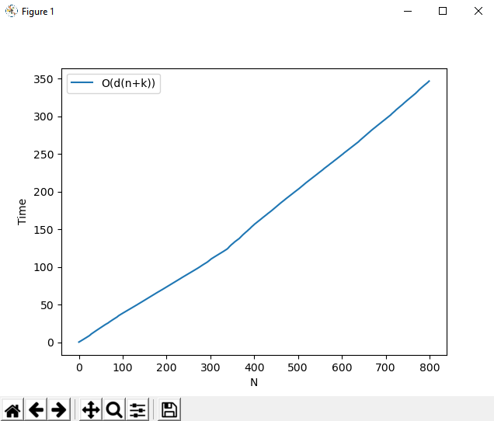

Slide 16
TIME COMPLEXITY
For the radix sort that uses counting sort as an intermediate stable sort, the time complexity is O(d(n+k)).
Here, d is the number cycle and O(n+k) is the time complexity of counting sort.
Thus, radix sort has linear time complexity which is better than O(nlog n) of comparative sorting algorithms.

Slide 17
BUCKET SORT
Bucket Sort is a sorting technique that sorts the elements by first dividing the elements into several groups called buckets.
The elements inside each bucket are sorted using any of the suitable sorting algorithms or recursively calling the same algorithm.
Several buckets are created. Each bucket is filled with a specific range of elements.
The elements inside the bucket are sorted using any other algorithm. Finally, the elements of the bucket are gathered to get the sorted array.

Slide 18
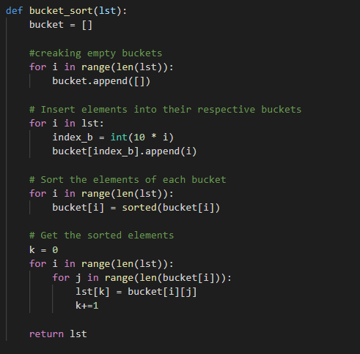

Slide 19
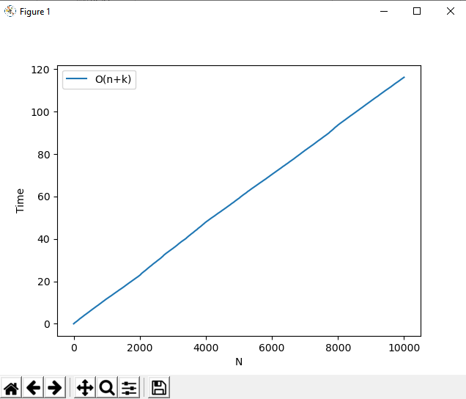

Slide 20
TIME COMPLEXITY
Worst Case Complexity: O(n^2)
When there are elements of close range in the array, they are likely to be placed in the same bucket. This may result in some buckets having more number of elements than others.
It makes the complexity depend on the sorting algorithm used to sort the elements of the bucket.
The complexity becomes even worse when the elements are in reverse order. If insertion sort is used to sort elements of the bucket, then the time complexity becomes O(n^2).

Slide 21
TIME COMPLEXITY
Best Case Complexity: O(n+k)
It occurs when the elements are uniformly distributed in the buckets with a nearly equal number of elements in each bucket.
The complexity becomes even better if the elements inside the buckets are already sorted.
O(n) is the complexity for making the buckets and O(k) is the complexity for sorting the elements of the bucket using algorithms having linear time complexity at the best case.

Slide 22
TIME COMPLEXITY
Average Case Complexity: O(n)
It occurs when the elements are distributed randomly in the array. Even if the elements are not distributed uniformly, bucket sort runs in linear time. It holds true until the sum of the squares of the bucket sizes is linear in the total number of elements.

Slide 23
Applications of Count sort
Mostly used when the range of numbers is small.
When the algorithm or application requires a linear complexity.

Slide 24
Applications of bucket sort
The input values is uniformly distributed over a range.
Mostly used when the values are float or decimal numbers.

Slide 25
Applications of radix Sort
Radix sort is implemented in
DC3 algorithm (Kärkkäinen-Sanders-Burkhardt) while making a suffix array.
Places where the range of numbers is very large.

